Slide 1
Monitoring
Log Monitoring and Analysis
Notes:
Notes to the Facilitator:
Welcome the participants and give them an overview of the module. Tell them that they will learn about the ‘Infrastructure Monitoring’ in this module.
Notes to the Participants:
You will learn about the ‘Log Monitoring and Analysis’ in this module.

Slide 2
Module Objective
At the end of this module, you will be able to:
Define the log monitoring and its objectives
Differentiate between log monitoring and log analysis
Explain various techniques around log analysis
List the advantages and scope of log analysis
Define the best practices for log analysis
List the available tools for log monitoring
Notes:
Notes to the Facilitator:
Explain the module objectives to the participants.
Notes to the Participants:
You will be informed about the module objectives.
At the end of this module, you will be able to:
Overview of Log monitoring
Objectives of log monitoring and analysis
Log Monitoring vs Analysis
Techniques around log analysis
Advantages and Scope of log analysis
Best practices for log analysis
Brief overview of tools available to do Log monitoring

Slide 3
Module Topics
This module covers the following topics:
Overview
Objectives of log monitoring
Log monitoring vs analysis
Log analysis techniques
Purpose and benefits of log analysis
Log analysis best practices
Tools overview
Notes:
Notes to the Facilitator:
Inform the participants about the topics that they will be learning in this module.
Notes to the Participants:
You will learn about the following topics in this module:
Overview
Objectives of log monitoring
Log monitoring vs analysis
Log analysis techniques
Purpose and Benefits of Log Analysis
Log analysis best practices
Tools overview

Slide 4

1.1 Overview
A log is a detailed list of events that happens to your system.
A system can be considered as a website, errors, user events, access to your server or system errors.
You can use logs to keep track of events happening in the system.
Log Monitoring is the process of reviewing collected logs of a system, which are constantly shipped from a system to the monitoring database.
Source: https://cdn.lynda.com/course/697718/697718-637286242412049634-16x9.jpg
Notes:
Notes to the Facilitator:
Give an overview of log monitoring to the participants.
Notes to the Participants:
In order to understand “Log Monitoring”, we need to first understand what are logs?
A log is a detailed list of events that happens to your system.Here, a system can be considered as a website, errors, user events, access to your server, or system errors. You can use logs to keep track of events happening in the system.
Also, logs can help you prevent vulnerabilities, raise alerts for bottlenecks, improve services, and so on. They’re invaluable assets when it comes to tracking and preventing problems.
Log Monitoring is the process of reviewing collected logs of a system, which are constantly shipped from a system to the monitoring database.

Slide 5

1.2 Why Log Monitoring is Required
Log monitoring is required due to following issues:
Troubleshooting issues
Knowing issues early
Detecting suspicious activities
Patterns
Source: https://library.scalyr.com/2018/07/19175224/iStock-495213850.png
Notes:
Notes to the Facilitator:
Explain to the participants why log monitoring is required.
Notes to the Participants:
Log monitoring is required due to following issues:
Troubleshooting issues: A log monitoring solutions brings all your logs to a centralized location with visualisation, this way if any thing blows up in any of system, it will be a great convenience to have a look at the events took place in the system and make a hunch towards the issue. This convenience eventually plays a vital role in fixing production issues in a jiffy.
Knowing issues early: Many times a big issue is a result of the cascading effect of a smaller issue which might happen earlier maybe minutes or hours. If we know about that smaller issue and get notified by the monitoring solution, a big outage can be avoided. This kind of situation is quite frequent with application, when there is an exception in the log events which eventually leads to outage.
Detecting suspicious activities: With the increase in number of online services, people are putting out their sensitive information to the websites, which are bread crumbs for cyber attacks, such malicious activities can be detected early if someone tries to break in the system. Log monitoring helps us pre-identify such attacks and prevent them.
Patterns: Over the period a lot of data can be collected which can be useful to track the growth points of the organisation in accordance with the decisions, this can help a company to take better decisions by learning from past decisions.

Slide 6
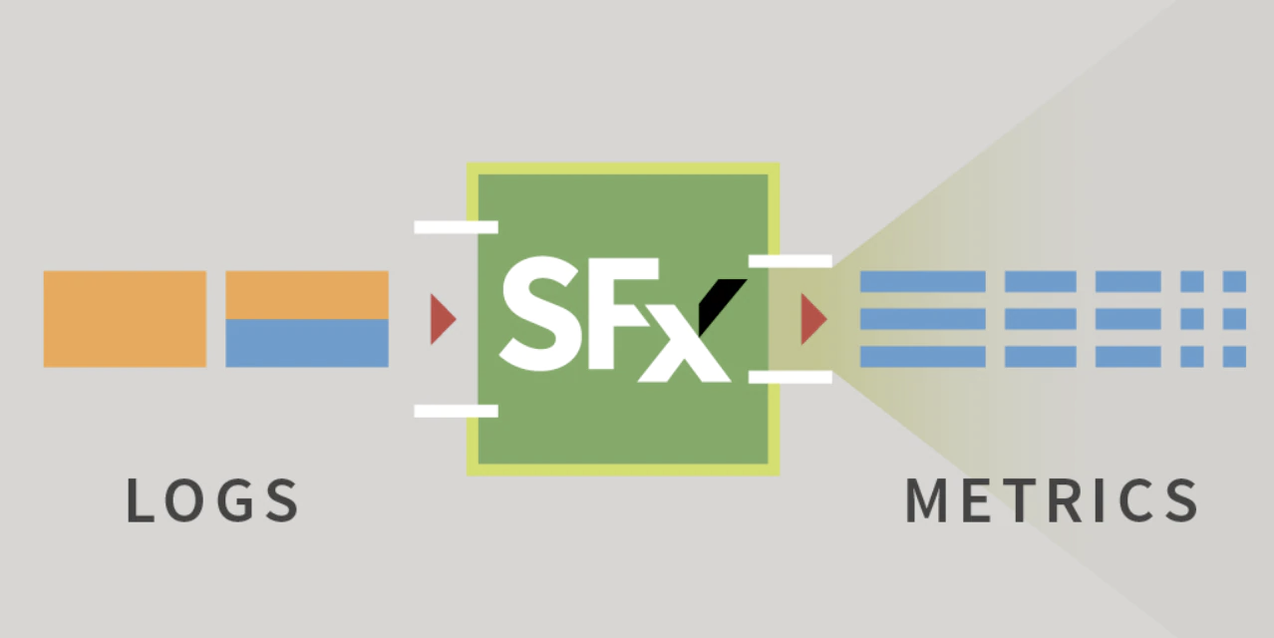
1.3 Metrics
One of the important thing is what metrics to be monitored?
Source: https://www.splunk.com/content/dam/splunk-blogs/images/2019/11/LogMetricization_blog_featured.png
Notes:
Notes to the Facilitator:
Explain the Metrics to the participants.
Notes to the Participants:
In a system there are lots of events going on, monitoring all of them is not wise because it can lead to overwhelming of collection of data which has many repercussions like slow querying, cost of managing etc. We need to choose from the source what needs to be monitored and how to segregate it.
Understanding the metrics: To get a proper understanding of your metrics, one needs to understand the whole system. To simply this one can differentiate between metrics in to two ways.
Resource metrics: These are related to operational side of project, like resource utilisation, CPU, Mem, requests type, etc.
Business metrics: These are the metrics which provides insight of the business, about the customer actions at various stages. These patterns can be vital in order to take calculated risks and decisions for the betterment of the organisations.

Slide 7
What did You Grasp?
Which metric helps the organisation to grow?
Resource metrics
System metrics
Business metrics
Metrics of activities of administrators
Notes:
Notes to the Facilitator:
Answer:
C. Business metrics

Slide 8




1.2 Objectives of Log Monitoring
The objectives of log monitoring are:
Resource Management
Business Analytics
Application Troubleshooting
Marketing Insights
Notes:
Notes to the Facilitator:
Explain the objectives of log monitoring to the participants.
Notes to the Participants:
There are various reasons an organisation must have a centralised monitoring solution, which can bring growth to the business.
Resource Management: To run an IT business there are a lots of resources required in terms of hardware, mainly servers and storage device takes a toll on budget. Hence, it becomes highly important to take care of those resources. For these reasons logs become invaluable asset to to keep your IT systems healthy, up and running.
Application troubleshooting: The application logs are the first thing which are looked up in case of any issue occurs. They help us identify the root cause of the issue, which can further analyse yo improve the performance of application and systems. Many times early detection is also possible to avoid any cascading effect.
Business Insights: When it comes to the business metrics, they are collected and preserved as treasure, because they carry valuable information related to the business insights. Critical information can be derived and further analysed to make decisions in the right direction. A centralised monitoring provides such insights in visual manner to have a complete understanding of the past business pattern.
Marketing insights: Analyses of logs can be used as a vital gain for digital marketers to gather understanding and analyze their campaign’s impact on visibility, traffic, conversions, and sales. Also, these marketing logs can be beneficial in revealing the new domains for SEO enhancements as they can reveal exactly how bots are crawling your website.

Slide 9
What did You Grasp?
Which objective of log monitoring can really help in maintaining the health of IT systems?
Resource Management
Application Troubleshooting
Business Analytics
Marketing Insights
Notes:
Notes to the Facilitator:
Answer:
A. Resource management

Slide 10
1.4 Log Monitoring vs Analysis
The act of collecting logs from a system or application and preserving them in a database is called Log Monitoring. Where as, the process of using those logs to fix issues or define business pattern is called Log Analysis.
Components including both:
Log Monitoring
Fetching logs from system/application
Shipping logs to central database
Providing interface for viewing logs
Setting up and maintaining the whole system
Log Analysis
Finding the right logs in case issue
Diagnosing the issue with correct observation
Finding patterns
Notes:
Notes to the Facilitator:
Explain the log monitoring vs analysis to the participants..
Notes to the Participants:
Log monitoring and analysis might seem similar because of the common thing involved, which is log, but they actually have different core meanings.
The act of collecting logs from a system or application and preserving them in a database is called Log Monitoring. Where as, the process of using those logs to fix issues or define business pattern is called Log Analysis.
Components including both:
Log Monitoring
Fetching logs from system/application
Shipping logs to central database
Providing interface for viewing logs
Setting up and maintaining the whole system
Log Analysis
Finding the right logs in case issue
Diagnosing the issue with correct observation
Finding patterns

Slide 11
What did You Grasp?
What is not a top mistake in log analysis?
Not keeping what you should
Not analyzing what you keep
Not rigidly separating metrics type
Not using log data to improve processes
Notes:
Notes to the Facilitator:
Answer:
C. Not rigidly separating metrics type

Slide 12

1.5 Log Analysis Techniques
This segregation is based on how we respond to an event triggered by monitoring.
Reacting to incident before it triggered: Proactive
Reacting to incident after it triggered: Reactive
Proactive
Reactive
Notes:
Notes to the Facilitator:
Explain the log analysis techniques to the participants.
Notes to the Participants:
Getting started with the log analysis is easy, but at the same time not having a proper technique will lead to beating around the bush and will lead you nowhere. So, it is better to have listed down few techniques, which might become handy.
Normalization
Pattern recognition
Classification and tagging
Correlation analysis

Slide 13




1.5 Log Analysis Techniques (Contd…)
The objectives of log monitoring are:
Normalisation
Classification and Tagging
Pattern Recognition
Correlation analysis
Notes:
Notes to the Facilitator:
Explain the log analysis techniques to the participants.
Notes to the Participants:
The objectives of log monitoring are:
Normalisation: In a large scale infrastructure the logs of each system should have a similar format or follow some guidelines, which makes a monitoring tool to gather logs across all system. If they are varying among system it will bring abnormality.
Pattern recognition: Every event, which happens in a system can be categorise into one, for example, CPU related metrics can be put under resource category whereas traffic related logs can be kept under network category. This segregation helps in querying the logs from a large collection of logs.
Classification and Tagging: In this technique, we put a label on tag on logs, which are similar rather having a logical segregation like identifying a pattern. Ideally tagging a keyword to similar kind of application can be done to have data of both streams together.
Correlation analysis: It is an approach in which correlation is found among lots of entries. This could be the entries related to similar events, identifying correlation is an essential step to draw some purposeful outcome.

Slide 14
What did You Grasp?
Logs from virtual systems should be __________ ?
Collected and processed with physical system logs
Kept separate from physical systems logs
Allowed to vanish with the systems they came from
Ignored except when PCI compliance is a concern
Notes:
Notes to the Facilitator:
Answer:
A. Collected and processed with physical system logs

Slide 15

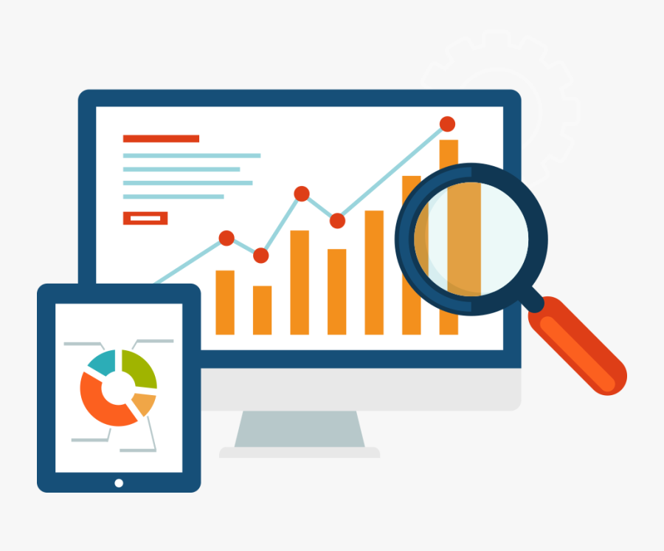


1.6 Purpose and Benefits of Log Analysis
Purpose of log analysis are:
Monitoring
Auditing
Debugging
Future Planning
Notes:
Notes to the Facilitator:
Explain the purpose and benefits of log analysis to the participants.
Notes to the Participants:
Monitoring: The primary purpose of this is that it can be used to monitor the usage of a product or service, sometimes checking on security reasons. For example, In an e-commerce business, someone is trying to breach the data of users, if it is in knowledge about the source of breach then the activity can be monitored via solution.
Auditing: The centralized monitoring solution is supposed to aggregate logs over along period of time, thi usually helps in quarter and annual auditing purposes especially in the financial industry. Considering example of finance industry, suppose a customer has made some transaction via payment gateway, which somehow didn’t succeed but on the portal it shows successful, to investigate further in this matter logs can be analysed for what led to such situation.
Debugging: A log monitoring analysis brings all your logs to a centralized location with visualisation, this way if any thing blows up in any of system, it will be a great convenience to have a look at the events took place in the system and make a hunch towards the issue. This convenience eventually plays a vital role in fixing production issues in a jiffy.
Future Planning: When it comes to taking decisions regarding business, we must have a look at the patter of the repercussions of past decisions, which can be visualised on a monitoring system. Logs help a lot when they are collected and preserved as a treasure, because they carry valuable information related to the business insights. Critical information can be derived and further analysed to make decisions in the right direction. A centralised monitoring provides such insights in visual manner to have a complete understanding of the past business pattern.

Slide 16
What did You Grasp?
Which monitoring suite offers a SAAS based solution?
Cloud monitoring
On-premise monitoring
Hybrid monitoring
Pay as per usage model
Notes:
Notes to the Facilitator:
Answer:
A. Cloud monitoring

Slide 17

1.7 Log Analysis Best Practices
The following are the best practices of log analysis.
Set a strategy
Structure your log data
Centralizing the log data
Practice end to end logging
Using identifiers
Real time monitoring
Notes:
Notes to the Facilitator:
Explain the best practices for log analysis.
Notes to the Participants:
To get a best of a system best practice must be considered. The following are the best practices of log analysis.
Set a strategy: To have a well organised monitoring setup a strategy must be used, otherwise down the lane when data size increases and sources of data increases you might find yourself manually managing the logs, which is not a likely business. While strategizing logging one should consider their use case and what strategy suits them best.
Structure your log data: In a large scale system the sources of logs are numerous systems, to have a common shipper and aggregator which will pull and push metrics from the system should not face any variability across the systems. Otherwise, it may bring inconsistency to the monitoring solution and require customisation at sources, which is an extra effort.
Centralizing the log data: One of the greatest benefit of log monitoring is that you get to visualise all of your logs at a central location, which eventually helps teams to debug, plan and recognise pattern in a easy way. To ensure this one must have a common solution across the infrastructure which is versatile enough to read across the platform.
Practice end to end logging: The benefits of log monitoring can only be leveraged when you are collecting all necessary metrics of a system, the monitoring solution won’t be fruitful if you only log application metrics or storage metrics. The ease which monitoring solution brings will be of no use if one has to log into server and check other metrics.
Using identifiers: They turn out to be really advantageous when you have to pinpoint the root cause of a problem for debugging, support and analytics. Having numerous Identifiers proves useful to track particular user sessions and identifying actions taken by individual users. Suppose If you know an identifier, then it becomes really easy to track down the log which you are looking for.
Real time monitoring: Whenever some change is brought to the system we want to know what affect it has on system, which can be monitored only by looking at logs. Real time monitoring becomes essential when a new rollout is being done or some major change has been brought to the system.

Slide 18
What did You Grasp?
The term filtering in log management means?
Aggregating all log files to a central place
Alerting on every entry in a log file
Reducing alert and report data to critical events
Maintaining terabytes of log archives in the cloud
Notes:
Notes to the Facilitator:
Answer:
C. Reducing alert and report data to critical events

Slide 19

1.8 Tools Overview
The prominent log monitoring tools available in the market:
Notes:
Notes to the Facilitator:
Explain the log monitoring tools to the participants.
Notes to the Participants:
The prominent log monitoring tools available in the market are:
Graylog
Loggly
Logstash: ELK stack
Splunk
Fluentd

Slide 20
What did You Grasp?
Why should organizations want to manage logs?
To be informed when something "interesting" happens involving a system, device, or application
To be able to do something in response to a security event
To keep a record of our responses to security events
To stay compliant
All of the above
Notes:
Notes to the Facilitator:
Answer:
E. All of the above

Slide 21
In a Nutshell
In this module, you learnt:
Overview of log monitoring
Objectives of log monitoring and analysis
Log monitoring vs analysis
Techniques around log analysis
Advantages and scope of log analysis
Best practices for log analysis
Brief overview of tools available to do log monitoring
Notes:
Notes to the Facilitator:
Share the module summary with the audience.
Ask the participants if they have any questions. They can ask their queries by raising their hands.
Notes to the Participants:
Now, you have reached the end of the module. In this module, you learnt:
Overview of log monitoring
Objectives of log monitoring and analysis
Log monitoring vs analysis
Techniques around log analysis
Advantages and scope of log analysis
Best practices for log analysis
Brief overview of tools available to do log monitoring

Slide 22
Next Module 6: Monitoring Techniques

